Slide 1
SPRING SECURITY
-Ritika Verma

Slide 2
What is spring security?
Spring Security is a Java/Java EE framework that provides authentication, authorization and other security features for enterprise applications.
This framework targets two major areas of application are authentication and authorization.
Authentication is the process of knowing and identifying the user that wants to access.
Authorization is the process to allow authority to perform actions in the application.

Slide 3
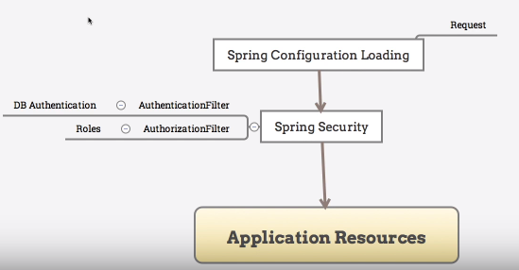
How Spring Security integrated to application?

Slide 4
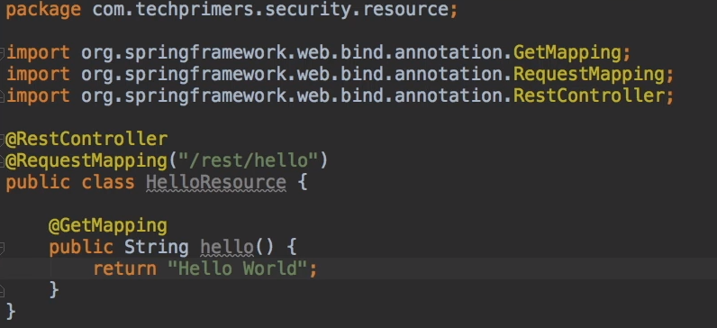
Example-Controller

Slide 5
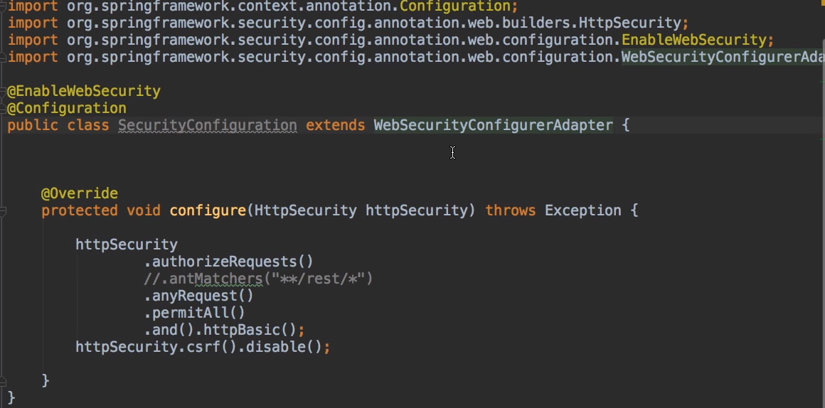
Example-SecurityConfig without Authentication

Slide 6
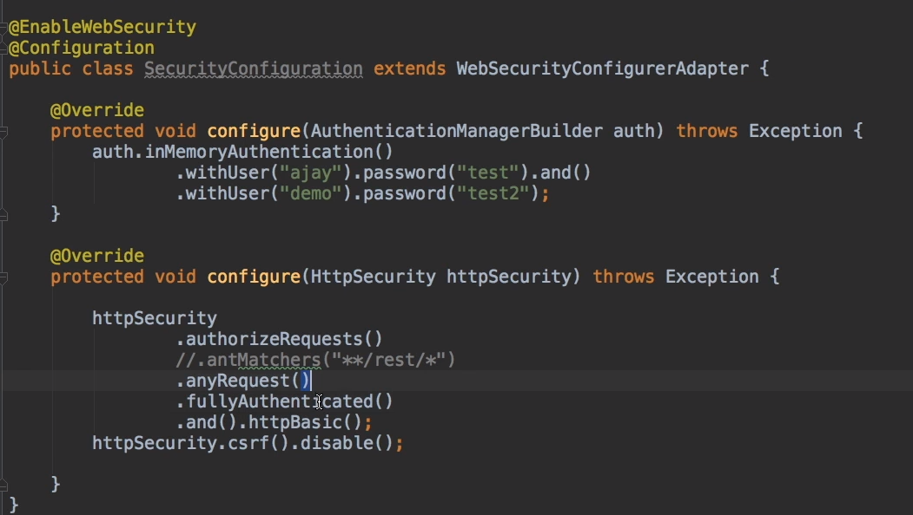

Example-SecurityConfig with Authentication

Slide 7
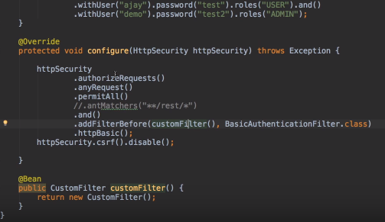
Creating Custom Filter

Slide 8
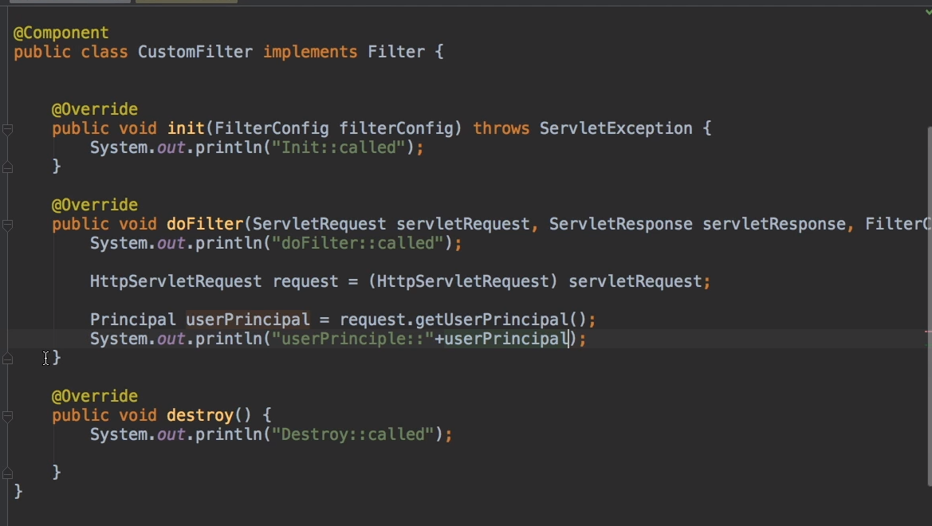

Slide 9
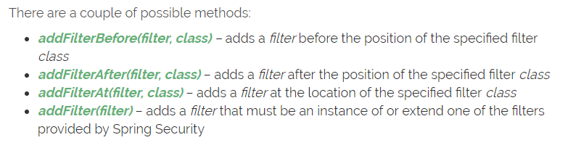
Methods of Custom Filter

Slide 10
THANK YOU

